Slide 1

TRAVELLER MANAGEMENT SYSTEM
BE HAPPY AND KEEP MOVING

Slide 2

WE ARE HERE
Reduce and Eliminate Expenses
Decide on Location
Hassle free moving
On time boarding
Multiple transport
Time saving
Security with validation
One stop solution

Slide 3



Make a Plan
Login Logout
1
Booking system
2
Transport management
3
Hotel reservation
4
Review system
5

Slide 4
REGISTRATION
REGISTER AS A MEMBER
NAME
DATE OF BIRTH
Email
Phone Number

Slide 5
WHY WE ARE
TO GIVE A RELAIBLE MOVING EXPERIENCE
ONE STOP SOLUTION FOR EVERY NEED
ANOTHER SOCIAL MEDIA PLACE FOR TRAVELLERS
TRAVELLERS CAN FIND SECURE MOVING THROUGH VALIDATE MEMBERSHIP
EMERGENCY MOVING JUST START ON ONE TAP
NO NEED MULTIPLE APPLICATIONS

Slide 6
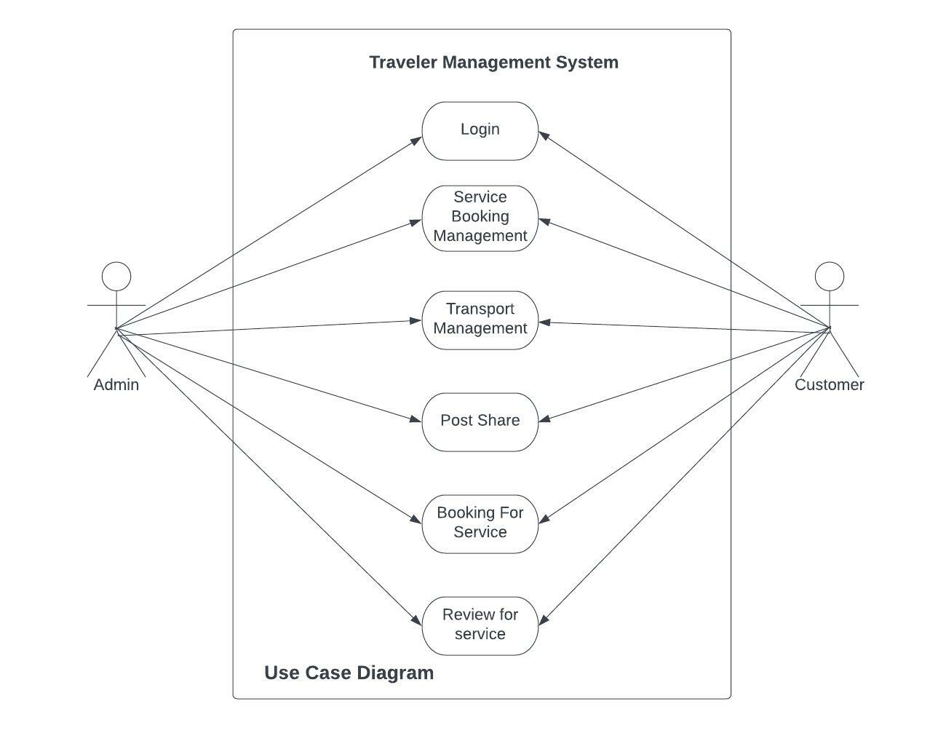
USE CASE DIAGRAM

Slide 7
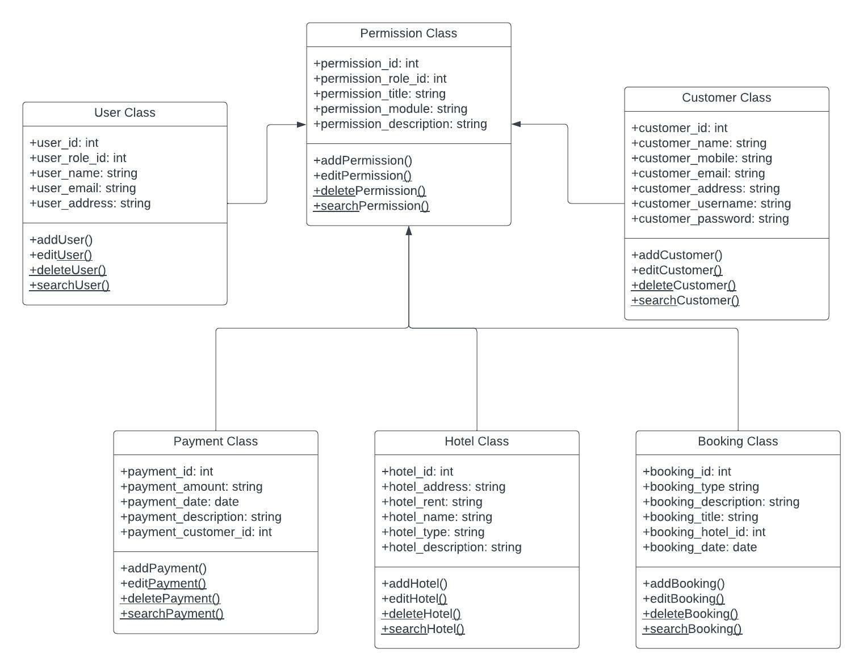
CLASS DIAGRAM

Slide 8
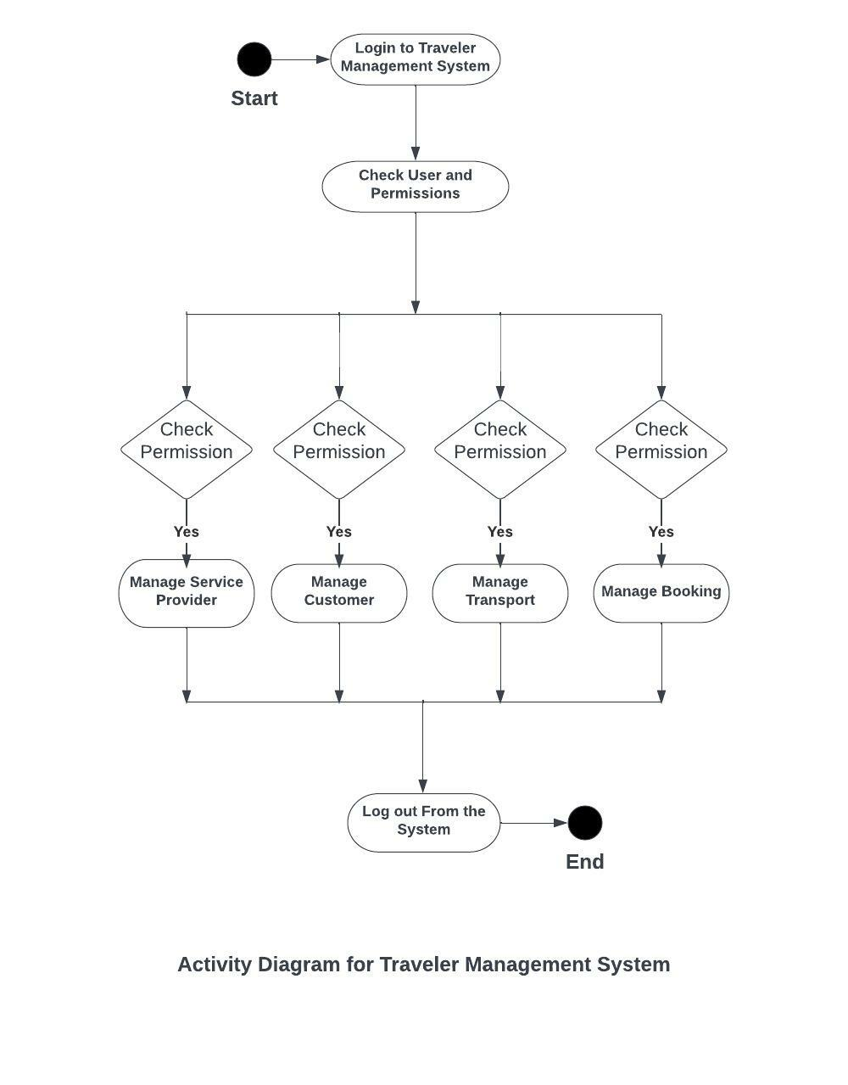
Activity Diagram

Slide 9

Thank you
MD Nazmul Huda, Ashikuzzaman Angon, Muhaimin Ahmad
Id No: 2014751001, 2014751010, 2014751276

